Slide 1
Mitigating Scalability Walls of RDMA-based Container Networks
Wei Liu , Kun Qian, Zhenhua Li, Feng Qian, Tianyin Xu, Yunhao Liu, Yu Guan, Shuhong Zhu, Hongfei Xu, Lanlan Xi, Chao Qin, Ennan Zhai
Notes:
Okay, thanks for the introduction, and Hello, everyone!
I’m Wei Liu and I’m here to share our experiences in understanding and addressing the scalability issues of RDMA-based container networks.
This is a joint work with Tsinghua University, Alibaba Cloud, University of Southern California, and UIUC.

Slide 2
Outline
Background
Motivation
Design
Evaluation
Conclusion
Notes:
Here is the outline of my presentation.
Let me first introduce the background and the problem we face.

Slide 3
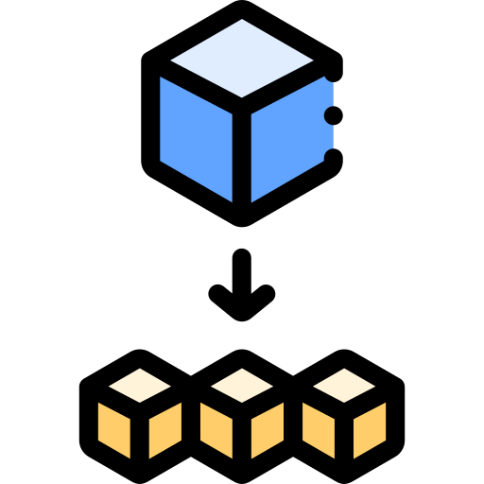
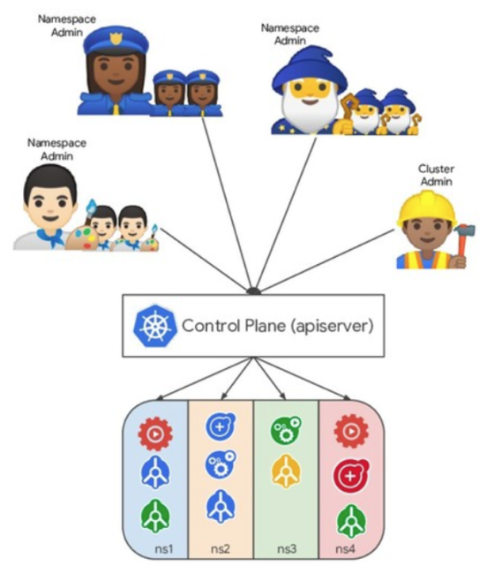
1. Background
Container is a pivotal technique
Building microservices
Deploying LLM training clusters at scale
Facilitating DevOps and CI/CD pipelines
Container networks enable seamless communications
Multi-tenancy
Network virtualization
High-performance container-to-container communications
Notes:
Containers have become a pivotal technology in modern computing, and it’s changing how we build and deploy applications. For example, they can serve as the foundation for microservices architectures—allowing us to break down complex applications into smaller, manageable, and independently scalable components.
Containers are now also widely used in large-scale AI workloads. They enable the deployment of massive LLM training clusters efficiently.
They’re also key to streamlining DevOps practices and CI/CD pipelines, accelerating software delivery while maintaining consistency across development, testing, and production environments.
So in the meantime container networks enables seamless communication among containers in data centers.
It typically supports critical features like multi-tenancy and network virtualization.
And most importantly for our discussion: container networks must deliver high-performance, low-latency communication.

Slide 4
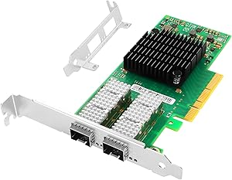
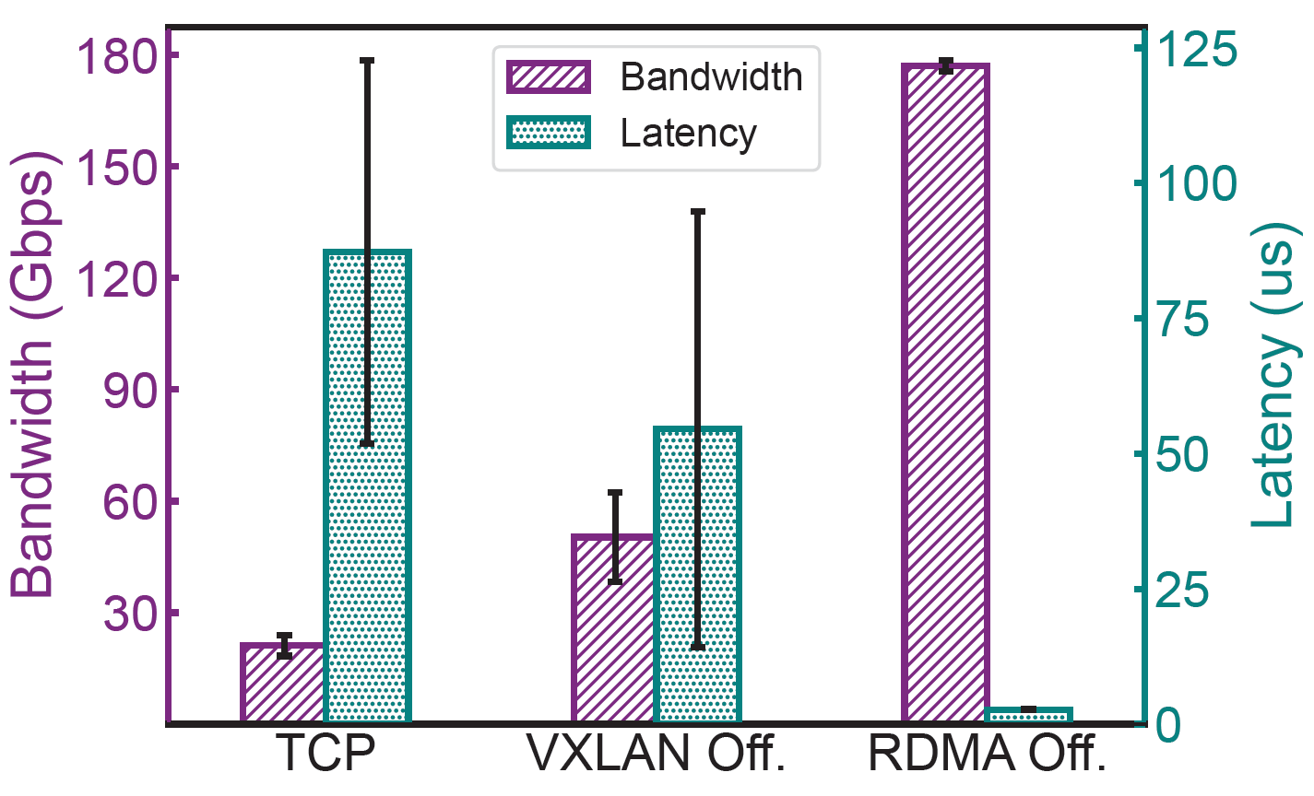
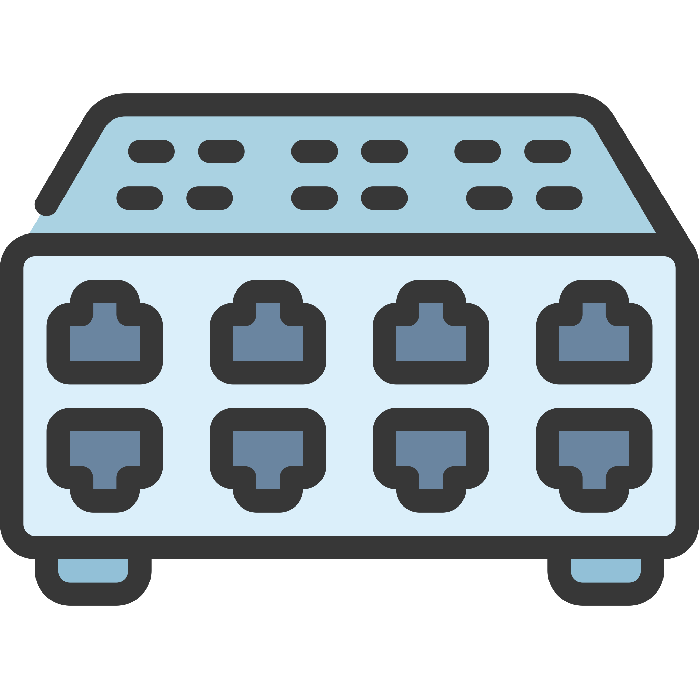
1. Background
RDMA-offloaded Container Network (RCN)
RDMA support
Hardware accelerated (through RDMA NICs)
Offloading packet switching for network virtualization
Host A
Host B
Containers
Containers
172.16.122.0/24
172.16.206.0/24
Software Switch
Software Switch
Hardware NIC
Overlay
Hardware NIC
10.1.1.1/24
Underlay
10.1.1.2/24
At least 3X
performance improvement
Physical Switches/Routers
Notes:
To achieve this goal, container networks are usually built based on RDMA NICs to offload data traffic and network functions from the host OS to the dedicated hardware.
In this way, network traffic can all be processed in hardware, and the packet switching and network virtualization can also be more efficient.
The resulting RDMA-offloaded container network (or RCN for short) is expected to have at least three times of performance gain compared to the traditional network stack inside the OS.

Slide 5
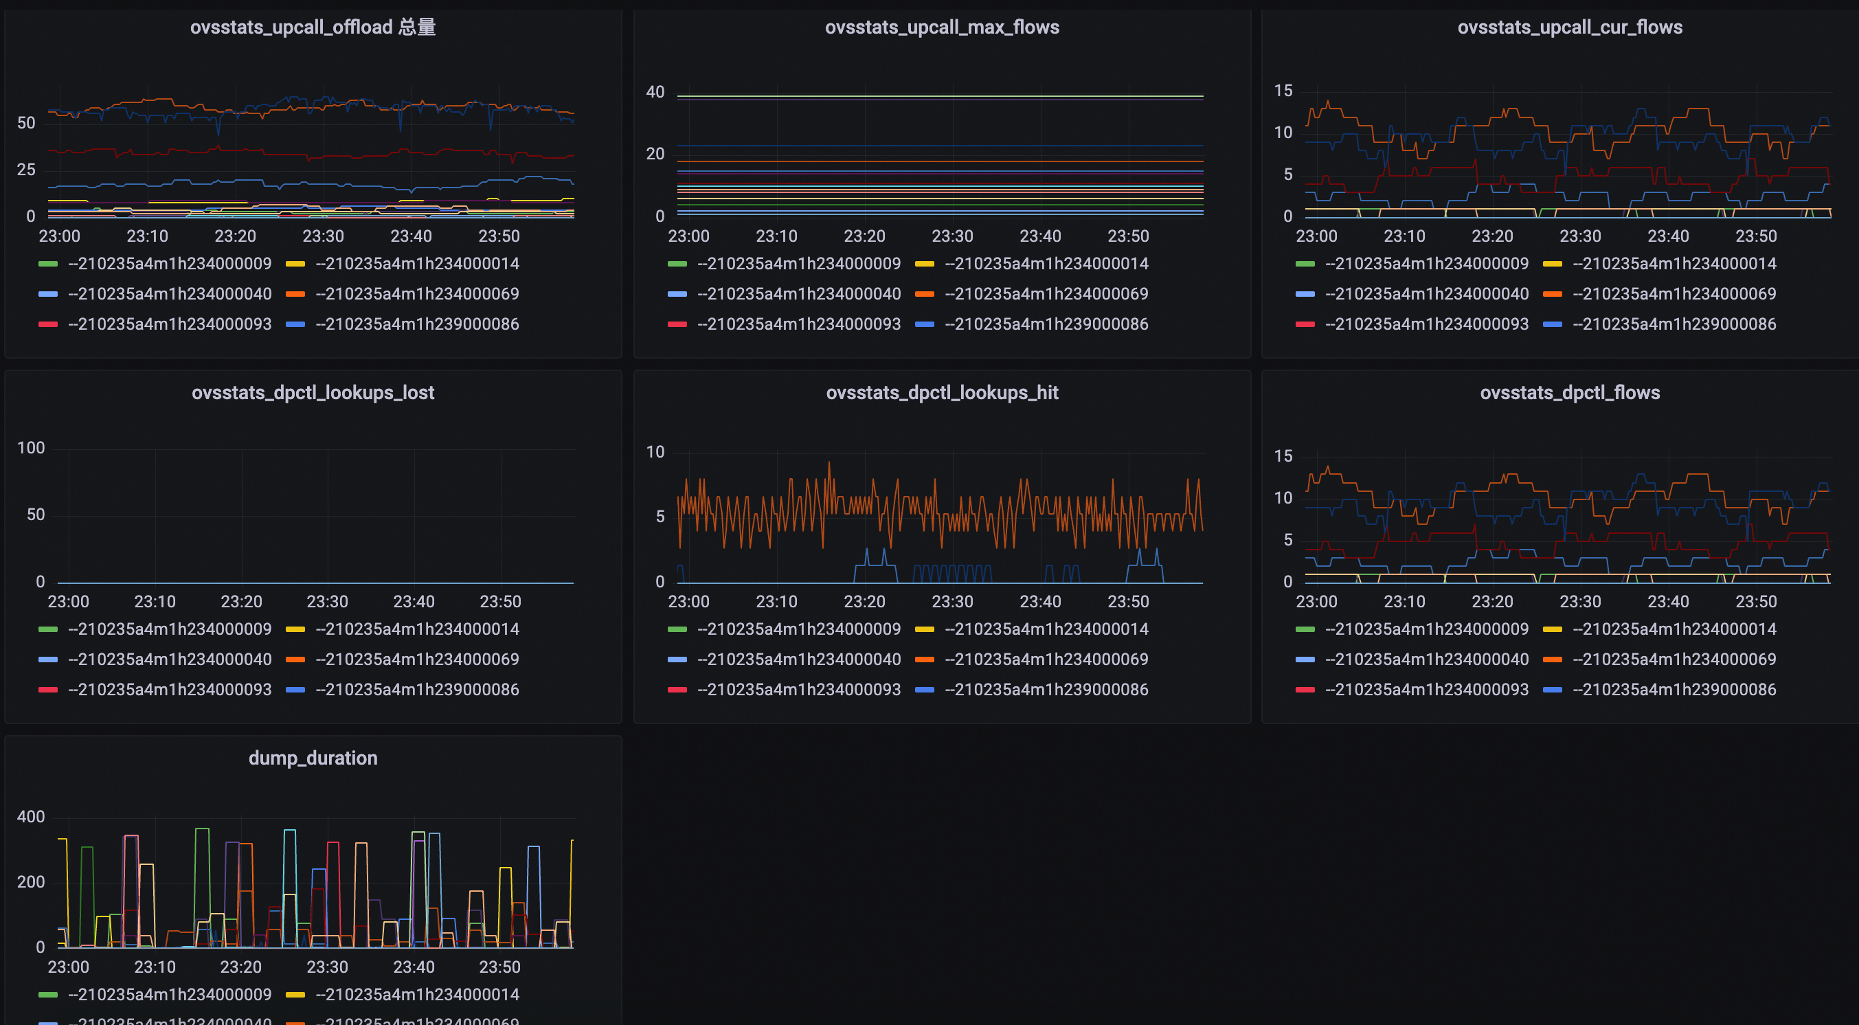
2. Motivation
An RCN in production has “scalability walls”
A typical RCN cluster in Alibaba Cloud
8K hosts
40K RNICs
0.5M active containers
0.4 M → 0.8 M containers
Bandwidth ↓87%
Latency ↑34X
Notes:
Despite its performance advantages, an RCN in production has scalability walls. Let’s look at a real-world example from Alibaba Cloud’s infrastructure: A typical RCN cluster has 8,000 physical hosts and 40,000 RDMA NICs (RNICs), serving around zero point five million active containers.
However, we find when the network scales from zero point four million to zero point eight million containers, the aggregated bandwidth over a specific RNIC can decrease by at most 87%, and the end-to-end latency can spike by 34 times.
At first glance, this is easy to understand because the hardware resources in RNICs are limited.
But as a cloud service provider, we wonder which components exactly are causing the bottleneck, and whether we can take active measures to avoid them.

Slide 6
2. Motivation
Measurement Study
Apr. 15, 2023 — Apr. 15th, 2024
Each host is equipped with 1 to 8 RNICs (mostly NVIDIA CX/BF series)
Data collection
RNIC and kernel statistics
Open vSwitch (OVS) status
Container network interface (Nimitz CNI in Alibaba) events
Notes:
To understand these scalability walls, we conducted a year-long measurement study from April 2023 to April 2024, analyzing a large-scale RCN deployment in Alibaba Cloud.
Each measured host is equipped with 1 to 8 RNICs.
In addition, we gather RNIC & Kernel Statistics such as the sending and receiving rates of RNICs and the number of connections.
We also monitor the Open vSwitch (OVS) and CNI events including the flow table lookups and subnet allocations.
This multi-layer telemetry enables us to detect performance anomalies immediately.

Slide 7
2. Motivation
Measurement Findings
Concrete symptoms of “scalability walls”:
Most are RNIC-related
Symptom | Layer | Ratio
Repetitive flow re-offloading | Virtual Switch | 17.1%
Kernel stagnation | RNIC driver | 5.9%
Kernel crash on new flows | RNIC driver | 5.2%
Slow flow state maintenance | RNIC hardware | 11.4%
Intermittent software forwarding | RNIC hardware | 15.3%
Poor performance of specific flows | RNIC hardware | 29.9%
PCIe link down when unbinding VFs | RNIC hardware | 8.4%
RNIC unresponsiveness | RNIC hardware | 6.8%
Notes:
Our study uncovered concrete symptoms of RCN’s scalability walls, each tied to specific layers of the stack.
Among these symptoms, over 80 percent are related to RNICs.
For example, we find offloading flows from containers to RNICs can lead to kernel instability when the workload of the RCN is heavy.
In some cases, the kernel can be stagnated, while in other cases, the kernel can even crash on offloading new flows.
And as you can see, RNIC hardware is also constantly triggering scalability issues.
We find when the number of flows increases on an RNIC, flows can intermittently go into software stack, which incurs significant performance degradation.

Slide 8
2. Motivation
Symptom——Repetitive Flow Offloading
OVS bears considerable lookup miss/lost events
Flow offloading is unstable
Lookup miss/lost events in CNI
Notes:
Here we show the concrete impacts and monitoring data of these symptoms in the real-world scenarios.
When repetitive flow offloading happens, our monitoring system reports that the Open vSwitch bears considerable lookup miss and loss events.
The RNIC seems to refuse to offload these flows and constantly pass it to the software stack for processing.

Slide 9
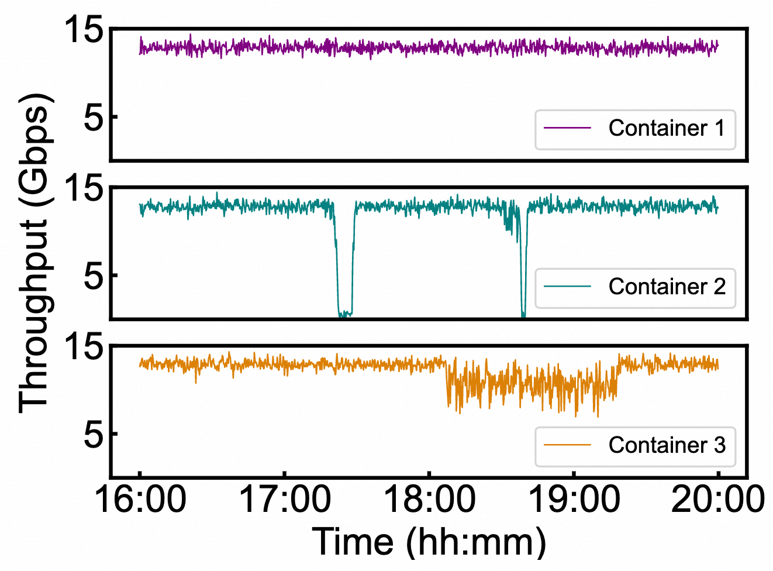
2. Motivation
Symptom——Repetitive Flow Offloading
Flows are intermittently processed by the software stack
Ideal Performance
Performance fluctuations
in LLM training
Notes:
This is reflected in the performance fluctuations in the container communications.
Here is the performance of an LLM training container cluster when flows are repetitively offloaded.
In the worst case, the throughput is reduced to nearly zero and the users even complain about it.

Slide 10
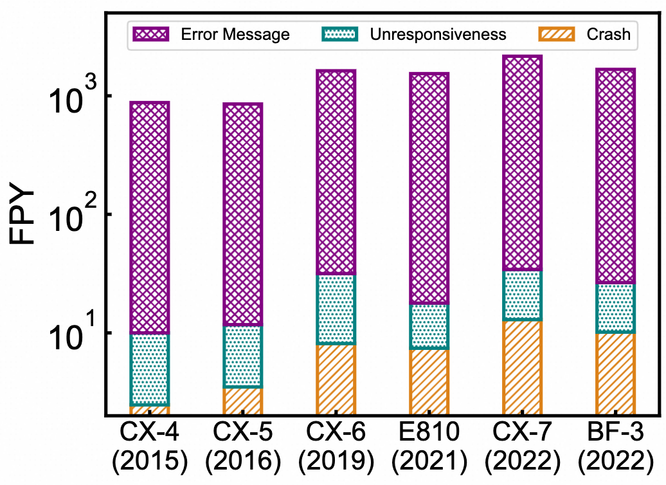
2. Motivation
Symptom——RNIC Driver Defects
The offloading of some flows in driver lead to kernel crash
Newer RNICs present higher failures per year (FPY)
Notes:
We also summarize the detailed failures per year of different RNIC models in production.
We notice newer RNICs present higher FPYs.
This can be attributed to two facts.
First, newer RNICs have more data to be synchronized.
And second, newer RNICs’ kernel drivers are more complex but not time-tested enough

Slide 11
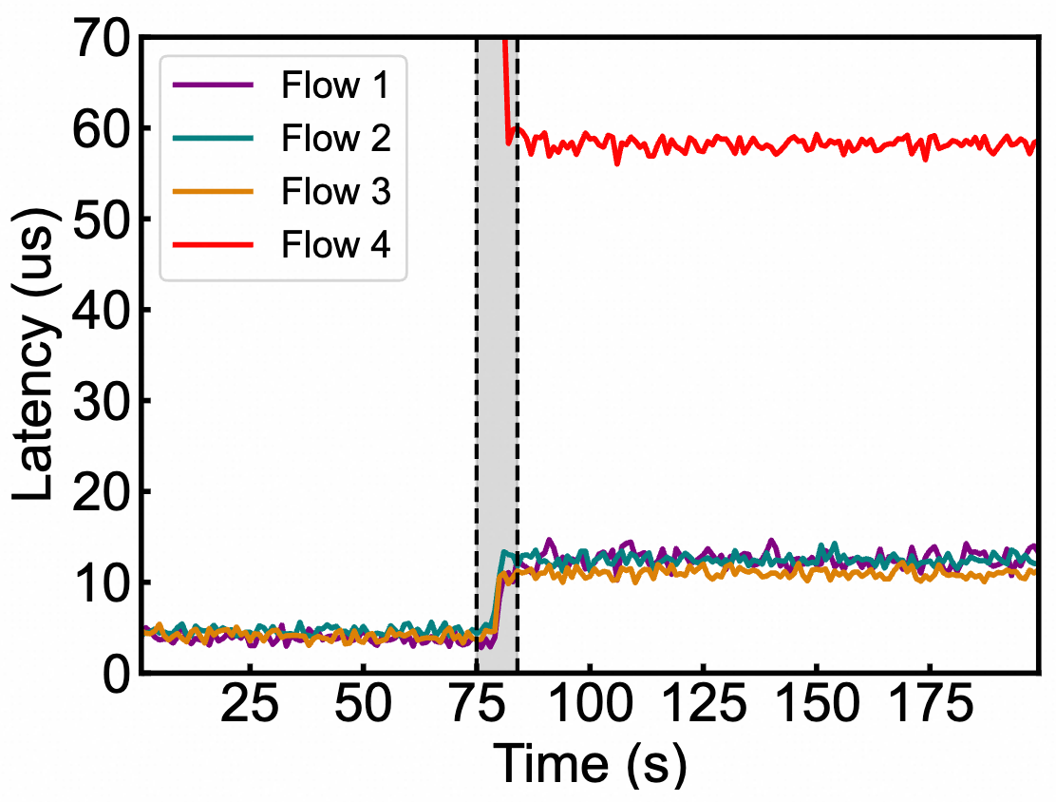
2. Motivation
Symptom——RNIC’s Unexpected Behaviors
Poor performance of specific flows
Performance degradation
after RNIC flow offloading
Notes:
Here is another example of undesired RNIC performance.
We notice the over all end-to-end latency can increase after a specific flow is offloaded to the RNIC.

Slide 12
2. Motivation
Symptom——RNIC’s Unexpected Behaviors
Unrecoverable poor performance
The performance cannot recover from the past high workload
Notes:
And even if the workload is reduced to a low level, the performance of the RNIC cannot recover from the past high workload.

Slide 13
2. Motivation
Challenges
A commodity RNIC is a blackbox
Limited visibilities into its internals
Its micro behaviors are not recorded in its datasheet
Difficult for RNIC vendors to reproduce our encountered issues
Cannot share real-world workloads
Our workloads push the RNICs to the extreme
Notes:
So, given the above unexpected performance of commodity RNICs, as a container service provider, we wish to understand why these issues happen and if we can take active measures to fix or avoid them.
However, this is not easy for container service providers like us in practice.
First, commodity RNIC is a black box.
We have very limited visibilities into their internal implementations, and their micro behaviors are not recorded in their official datasheets.
Second, although we can resort to RNIC vendors for some kinds of help, it is still difficult for them to reproduce our encountered issues since we cannot share real-world workloads to them due to the security and privacy reasons,
While our production workloads push the RNICs to the extreme.

Slide 14
3. Design
ScalaCN——Performance Testing and Modeling
Key idea—infer the RNICs’ architecture model and performance model
Today’s RNICs in an RCN provide:
RDMA verb interface for bypassing software stack
eSwitch interface for efficient packet forwarding and transformation
Use RNICs’ common abstractions for performance testing
A greybox-based approach
Notes:
To address the above dilemma, we present ScalaCN, an RNIC performance testing and modeling tool for container service providers.
Our key idea is to infer the architecture and performance model of the blackbox RNICs.
Our key insight is that today’s RNICs in an RCN provide
RDMA verb and eSwitch interfaces for bypassing software packet processing, so as to efficiently forward packets among containers in the same host or across different hosts.
In other words, our method uses RNICs’ common abstractions for performance testing and modeling.
It fundamentally differs from existing blackbox testing or white box analysis, as we take advantage of our domain knowledge, which is more like a greybox approach.

Slide 15
3. Design
ScalaCN——Greybox RNIC Testing and Optimization
Hardware abstractions in RDMA verbs
Queue Pair (QP), Completion Queue (CQ), Work Queue (WQ)
eSwitch: embedded switch in RNICs
Conform to the switchdev model of Linux kernel
In a match-action manner
Notes:
Here is how we conduct the testing.
We first build different testing dimensions for each RNIC.
For RDMA verbs, we configure the different RDMA hardware resource like QPs and CQs.
For the eSwitch interface, it is actually a bunch of flow tables that work in a match-action manner.
In fact, this has become the de fact standard in an RCN for packet switching.
So, as you can see, when an RCN packet goes from the container into the RNIC, it will first be queued and dequeued for buffering, and then the RNIC queries the offloaded flow tables for packet matching, virtualization, and forwarding.
We then change one input workload dimension, for example, the number of QPs and the number of flow table entries, while controlling the other dimensions unchanged, so as to test which input workload dimension contributes to the possible performance degradations.

Slide 16
3. Design
ScalaCN——Greybox RNIC Testing and Optimization
Exponential search space
RNIC is highly configurable
Examples
NVIDIA CX series has at least 192 bits
for packet matching
Different QP, CQ, and WQ combinations
struct mlx5dr_match_spec {
u32 smac_47_16;
u32 smac_15_0:16;
u32 ethertype:16;
u32 dmac_47_16;
u32 dmac_15_0:16;
u32 first_prio:3;
u32 first_cfi:1;
u32 first_vid:12;
u32 ip_protocol:8;
u32 ip_dscp:6;
u32 ip_ecn:2;
u32 cvlan_tag:1;
u32 svlan_tag:1;
u32 frag:1;
u32 ip_version:4;
…
};
Notes:
However, we face a key challenge that today’s RNICs are highly configurable.
For example, the NVIDIA ConnectX series RNICs has at least 192 bits for packet matching in flow tables.
Each of these mask bits can be configured individually.
Also, the number of QP, CQ, and WQ combinations further adds to the exponential testing space.

Slide 17
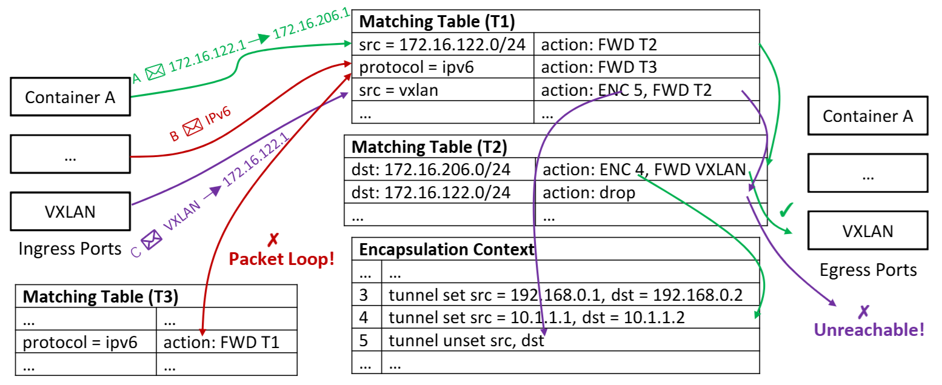
3. Design
ScalaCN——Combinatorial Causal Testing
Efficient testing with topological restrictions
Key idea: leverage the input dependencies to filter out the combinations that lead to packet loops or unreachability
60X faster
Notes:
To address this challenge, we propose combinatorial causal testing.
Our key idea is to leverage the input dependencies to filter out the combinations that lead to packet loops or unreachability.
In this figure packet A can be correctly delivered to the destinations, while packet B goes into forwarding loops and packet C goes to an unreachable destinations.
In this way of optimization, we can speed up the testing by 60 times.

Slide 18
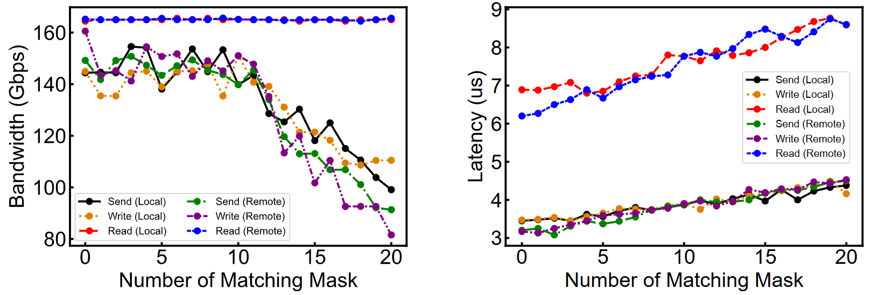
3. Design
ScalaCN——Causal Inference
Identify concrete configurations that lie in the critical path
Refine the critical path through permutation removal and sensitivity analysis
Notes:
Through the above testing, we can refine the critical path of packet processing inside an RNIC, by building the causal relations between the input configuration changes and the actual performance.
In particular, we find that for the NVDIA ConnectX series, the number of matching mask queries in flow tables can significantly affect the scalability of the RCN.

Slide 19
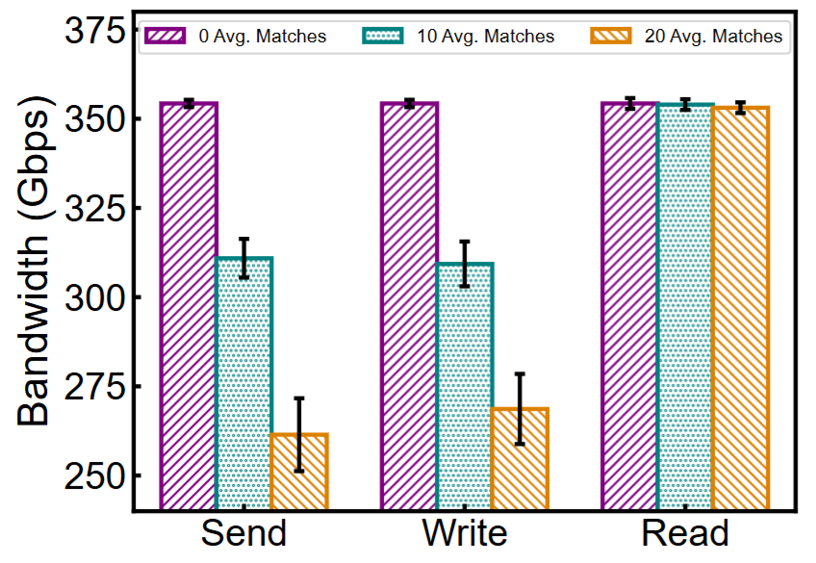
3. Design
ScalaCN——Performance Interpretation & Prediction
Sequential matching mask query →Poor performance of specific flows
… | Packet Queue | …
Flow Table 0x2: Type=FDB, Priority=0x4
Ingress Packets
Flow Group 0x3: UDP_DPORT(0xFFFF), IP_DST(0xFFF0)
SRC
10.1.1.2
DST
10.1.1.1
VXLAN_SRC
172.16.206.2
VXLAN_DST
172.16.122.3
Payload
FTE 0x8
FTE 0x9
172.16.122.3
Flow Table 0x1: Type=RX, Priority=0x3
Forward to the VF Port of Destination Container
Flow Group 0x1: IP_SRC(0xFF80)
× No Match
FTE 0x1
FTE 0x2
FTE 0x3
Flow Group 0x2: IP_DST(0xFFF0)
10.1.1.1
FTE 0x4
FTE 0x5
FTE 0x6
FTE 0x7
VXLAN
Decapsulation
Notes:
This is because different matching masks in flow tables are organized as different flow groups inside the RNIC.
When a packet is dequeued, it will sequentially query different flow groups.
Such queries increase the packet processing complexity.
For example, when the average flow group queries is ten, the bandwidth of ConnectX-7 RNIC bears 50 Gbps loss, and when this number increases to twenty, the loss increases to 100 Gbps.
In contrast, increasing the number of flow table entries inside a flow group hardly affect the performance.
We assume that flow table entries within the same flow group is organized as a hash map.
With ScalaCN, it is easier for container service providers like us to understand the performance impacts of different RNIC components.

Slide 20
3. Design
ScalaCN——Performance Interpretation & Prediction
Sequential mask query →Poor performance of specific flows
QP contention→Proportional performance degradation
Inconsistent flow counter→Flow re-offloading
VXLAN context overflow→Kernel stagnation
Notes:
Apart from the above performance interpretation, we can also explain other performance issues as we have previously reported.
For example, we find certain RNICs’ flow counters are not updated in time when the network scales up.
This makes the OVS mistakenly believe that the corresponding flow on the data plane has no actual traffic, leading it to delete the flow by mistake and thereby forcing the traffic to go through software.
So, from the view of the control plane, the flow hits the software OVS and thus needs to be re-offloaded.
And even worse, we notice that when we offloads more than seven thousand VXLAN context, the ConnectX-six RNIC can be unresponsive, leading to the kernel driver consistently waiting for its response.
And as a result, the kernel stagnates, and finally can even crashes, which affects all the containers in this host.

Slide 21
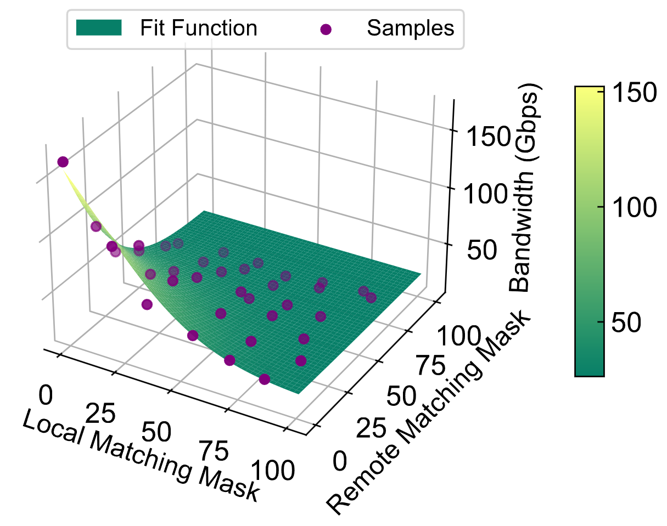
3. Design
ScalaCN——Performance Interpretation & Prediction
The performance of CX series RNICs can be predicted as
$$BW\left(Q_{l},Q_{r}\right)=u∙e^{\frac{−{\left(Q_{l}−m\right)}^{2}+{\left(Q_{r}−n\right)}^{2}}{2∙v^{2}}}+w$$
$$LAT\left(Q_{l},Q_{r}\right)=a∙Q_{l}+a∙Q_{r}+c$$
Notes:
Besides the interpretations for the unexpected performance and the scalability walls,
ScalaCN also helps to build the performance model for performance prediction in production.
As we have identified the bottlenecked components in flow group queries, we predict the bandwidth and latency through statistical fitting over the number of flow group queries.
As you can see, we can predict the bandwidth of an RNIC using a radial basis function, while the packet processing latency can be predicted using a simple linear functions.
ScalaCN helps us to predict when the performance issue is likely to happen, so that we can take active measures to mitigate them.

Slide 22
3. Design
ScalaCN——Proactive Performance Optimization
Packet matching forms the major bottleneck in production
Hyper Matching Mask
Mask 0x10: All Header Fields
FE 0x1: IP_SRC=172.16.122.1, IP_DST= 172.17.206.2, PORT=4789, …
FE 0x2: IP_SRC=172.10.31.98, IP_DST=172.8.30.1, PORT=8472, …
…
Cascading Matching Masks
Mask 0x12: IP_SRC (0xFFF0), IP_DST (0xFF00)
FE 0x21: IP_SRC=172.16.122.0/24, IP_DST= 172.17.0.0/16
FE 0x22: IP_SRC=172.10.31.0/24, IP_DST=172.8.0.0/16
Hyper FE
Activation
Mask 0x13: IP_SRC (0xFFF0)
FE 0x31: IP_SRC=172.16.122.0/24
FE 0x32: IP_SRC=172.10.31.0/24
Mask 0x14: IP_DST (0xFF00)
FE 0x41: IP_DST= 172.17.0.0/16
FE 0x42: IP_DST=172.8.0.0/16
Notes:
With the performance insights from ScalaCN, we proactively optimize the performance of our RCN under high workloads.
We organize the offloaded flow tables as a multi-level cache to minimize the average flow group query delay.
Specifically, we divide flow groups into hyper and cascading flow groups.
The former match all fields of a packet, so that all flows can be recorded in the headmost flow group for the minimal delay.
Of course, this can quickly fill up the hyper flow group.
So we also set cascading flow group after the hyper group for matching a broader range of packets.
In this way, ScalaCN ensures that most of the packets queries only around once in the flow groups.

Slide 23
4. Evaluation
Testbed
Middle-Scale RCN Configuration
50-node cluster with heterogeneous RNICs (CX-4/CX-5/CX-6/CX-7/BF-3/E810)
4 RNICs per host
Avoid inter-operations of different RNIC models
Real-World Traffic Generation
Large model training workloads
O(4M) daily flows, 150-400 Gbps throughput per RNIC
Metrics
Packet forwarding bandwidth
End-to-end latency
Notes:
We evaluate ScalaCN using both middle-scale RCN and real-world workloads.

Slide 24
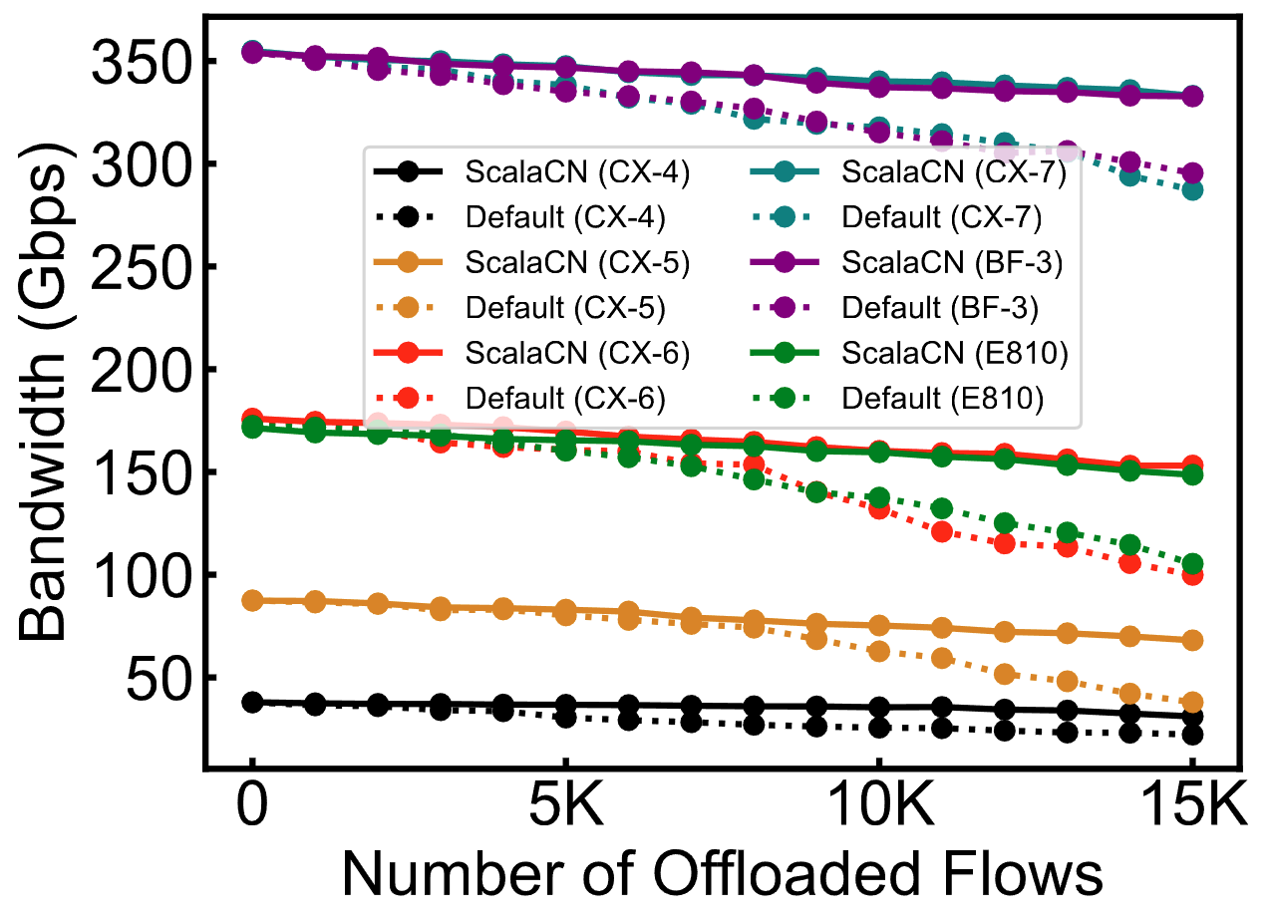
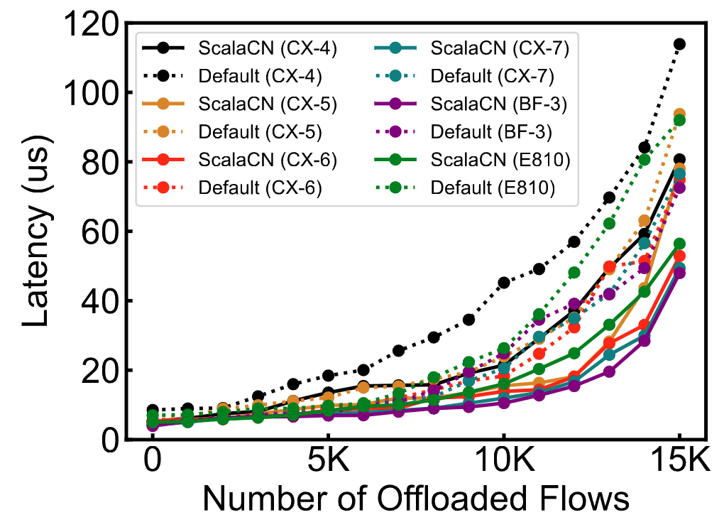
4. Evaluation
Major results
Microbenchmarks
ScalaCN significantly improves the performance by ~40% under heavy workloads
Notes:
The evaluation shows that ScalaCN significantly improves the performance by forty percent in micro benchmarks.

Slide 25
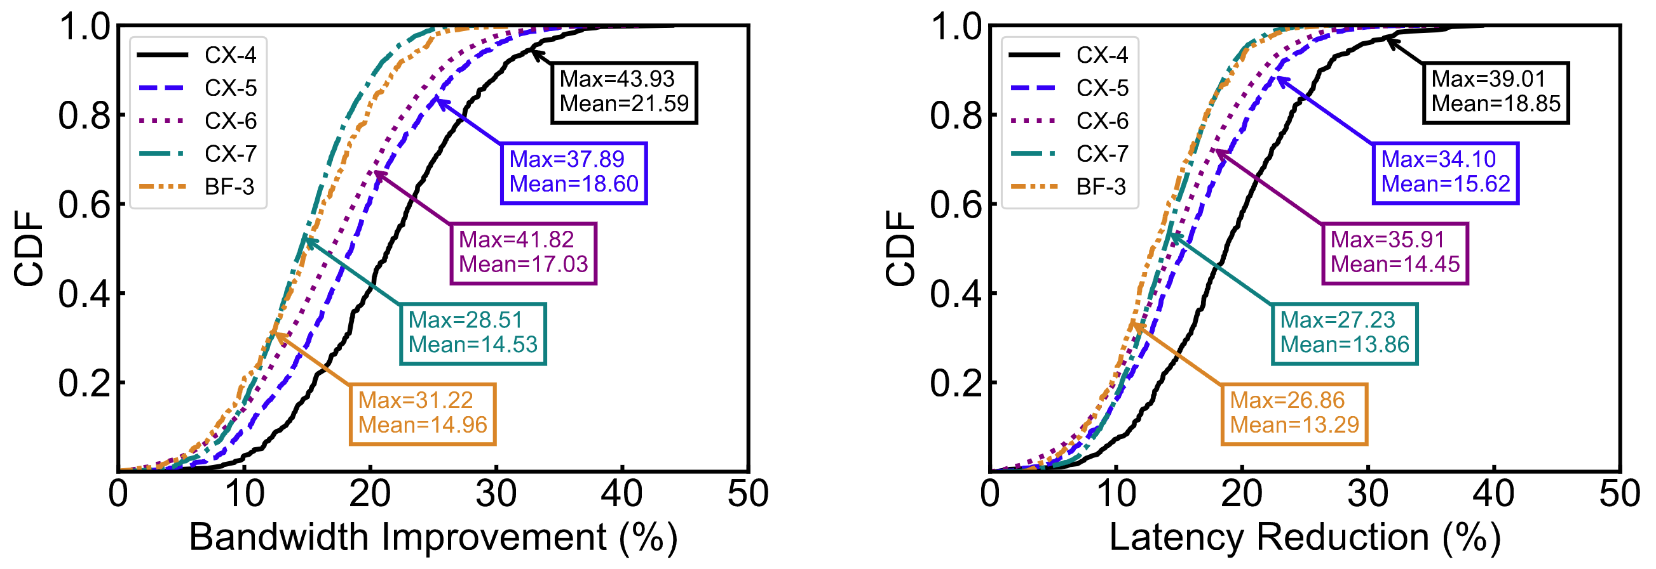
4. Evaluation
Major results
ScalaCN in production
ScalaCN significantly improves the performance by ~17% on average in production
Notes:
And improves the performance by seventeen percent in production given the high dynamics of the production workloads.

Slide 26
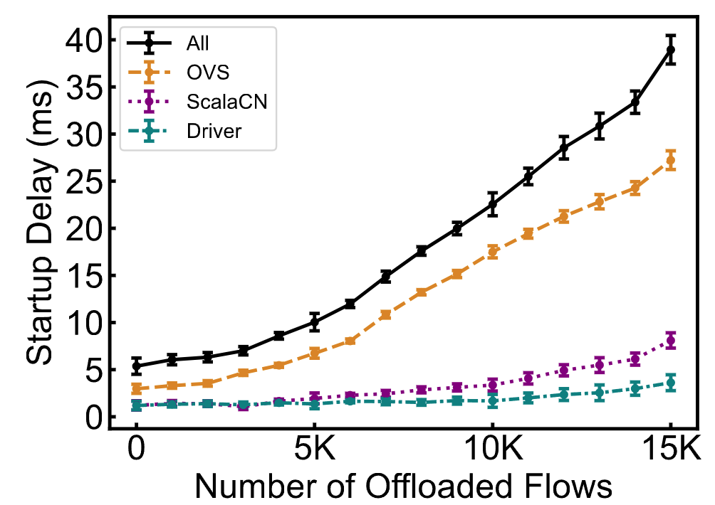
4. Evaluation
Beyond performance improvements
Flow startup delay
ScalaCN incurs negligible side effects on startup performance
Notes:
Although ScalaCN determines the flow table organization before offloading flows, it incurs negligible side effects on flow startup performance.

Slide 27
5. Conclusion
We conduct the first study to uncover the scalability wall in a large-scale RCN, and pinpoint the culprit to be RNICs.
We devise combinatorial causal testing based on RNICs’ common abstractions, so as to efficiently approximate RNICs’ internals and infer the root causes of performance issues.
We devise an effective method to accommodate RNICs to RCN scaling. Evaluation on real-world workloads and the feedback from vendors confirm its efficacy. We are now gradually deploying ScalaCN over the production RCN.
Code and data are released at https://scala-cn.github.io/
Thanks!
Q & A
Special thanks to Tsinghua Deng Feng Fund!
Notes:
In summary, in this work we conduct the first study to uncover the scalability wall in a large-scale RCN, and pinpoint the culprit to be RNICs.
To address this, we devise combinatorial causal testing based on RNICs’ common abstractions, so as to efficiently approximate RNICs’ internals and infer the root causes of performance issues.
We devise an effective method to accommodate RNICs to RCN scaling. Evaluation on real-world workloads and the feedback from vendors confirm its efficacy.
Finally, this work is specially supported by Deng Feng Fund.
Thank you! And I’m ready for Q&A!

